Slide 1
Who ACTS? An exploration of Self as Context
Michael Baugh, LCSW
California Institute of Integral Studies
Notes:
Good morning, and welcome! I want to begin with two stories I’m hoping will be a little bit funny. I know it’s early in the morning after a night at the follies, but if a couple of you can manage to laugh I’ll feel better about standing up here.
Nasruddin is a character in many Middle Eastern jokes, but he has a Sufi way of pointing at what’s true: In this story, Nasruddin walks into a jewelry store, walks around for few moments, and then approaches the clerk at the counter. He says to the clerk, “Did you see me walk in here just now?” The clerk says, “Yeah”. Nasruddin says, “Have you ever seen me before?” The clerk says, “No.” And Nasruddin says, “Then how do you know it’s me?”
The other story is from Mitch Hedberg, a dead comedian that my son really likes. In one of his sketches, Hedberg tells a story about going to a radio station to do an interview promoting his comedy CD. He says, “When I came in the door, the DJ said, “Who are you? I didn’t know if he was really deep, or if I had gone to the wrong radio station.”
So to check out whether you are in the right room, this is a workshop called “Who ACTS? Etc.” And I manage to pass in most social situations as being Michael Baugh. I teach 3rd wave behavioral treatments at the California Institute of Integral Studies, and have been a 40-some year student and teacher of mindfulness and spiritual paths.
If these jokes are funny, why are they funny? Well, it’s got something to do with confusion that can occur among the three kinds of self that we talk about in ACT –
Pop quiz, to see how much you drank at the Follies last night: What are the three kinds of self? I’m going to assume that by this point in the conference, even those of you who’ve never been much exposed to ACT have heard about “self as content”, “self as process” and “self as context, perspective-taking, whatever.” Being in the wrong radio station is somewhere in the first two kinds of self, whereas the deep version of “who are you?” points into the mystery of what’s aware of all of this. And it’s into that deep version that we’re here to explore in this workshop.
I’d like to ask you to get comfortable in your chairs, and either close your eyes or look softly at some point out in front of you. You can notice the sounds in the room, what your body is feeling like, but before you go into official “mindfulness” mode like you’ve done so many times, trying to quiet your mind and become silent and still, I’d like you to see if you can notice what is already totally silent within you, even as it hears sounds. What is already still, even as it perceives the motion of your breathing. Continues….

Slide 2
Please make sure to sign in on the yellow sheet, to get credit for being here.

Slide 3
“… we believe that in these difficult and perilous times there is a desperate need for a type of spirituality that will allow our behavior to come under more effective control by the direct contingencies.” Hayes, et al, RFT,p.253

Slide 4
Sit down and be still, my friend. For you are drunk, and this is the edge of the roof!
-- Rumi

Slide 5
“In short, RFT suggests that spirituality is an experience of “transcendence” or “oneness” that comes when the literal, analytic, and evaluative functions of relational framing are massively reduced, and the relation functions of I, HERE, and NOW are allowed to predominate.” RFT, p.243

Slide 6
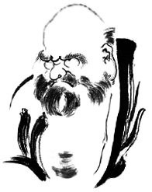
Do not strive to seek the truth, only cease to cherish opinions. --Third Chinese Patriarch of Zen

Slide 7
20 Minute Who ACTS? 1 Video of Dialog with Steve Hayes about ACT and enlightenment may be found on YouTube at http://www.youtube.com/watch?v=FwHZ8BiW2jg

Slide 9
Making Sense of Spirituality

Slide 10
“It is not my interest … to say literally that God or spirit in a religious sense does not exist independent of humankind. To the contrary, God could have created the very mechanisms I am describing that makes spirituality knowable. The paper is only meant to talk about spirituality within the game we call science. Hayes, 1984

Slide 11
“It is an inherently spiritual process in the sense that this kind of perspective taking cannot be solely the product of logic but must also be based on one’s firsthand experience of making contact with a transcendent sense of self.”
ACT TWO, p.153.

Slide 12
It can’t be taught – It has to be caught! -- Joe Miller

Slide 13
Behaviorists can -- and should -- model spiritual experience.

Slide 14
“Spirit” means “not matter” -- not a “thing”.
“Spirit” means
“not matter”–
not a “thing”.
Notes:
The OED defines "spirit" as an "incorporeal or immaterial being" and as a "being or intelligence distinct from anything physical."

Slide 15
Where can we look for what is “not a thing”? In the “perspective” of “I”, which is created by verbal processes.
Notes:
There is a behaviorally sensible event that corresponds quite well to the characteristics mentioned. To see it we will have to examine an obvious area: verbal behavior.
“In arranging conditions under which a person describes the public or private world in which he lives, a community generates that very special form of behavior called knowing... Self-knowledge is of social origin.”
Supposedly this happens through such things as questions like "What happened to you yesterday? What did you see? What did you eat?" and so on.
“The key verbal relations in the development of perspective taking are “deictic,” which means “by demonstration”…. This relationship (“here” versus “there”) is learned over hundreds if not thousands of examples; what is consistent across examples is not the content of the answer but rather the context, or perspective, from which the answer occurs. That is the case with all other deictic frames, such as I/you, we/they, and now/then.” Second Edition p.86

Slide 16
"It is only when a person's private world becomes important to others that it is made important to him" (Skinner, 1974, p. 31).
Notes:
What seems to have been missed in most behavioral accounts is that seeing seeing cannot be all there is to self-awareness. It is also critical to the verbal community that this behavior occurs from a given and consistent perspective, locus, or point of view…. Reports of seeing (i.e., seeing seeing) must be from the point of view of you.
[Okay, now here is where we are starting to look inside of ourselves, to try to look at what’s looking. From here on out, please feel free to close your eyes at any point, and investigate the feeling that these words invoke within you. We’re looking for what has not been seen before, or maybe glimpsed in a fleeting manner, or maybe cannot really be seen at all, but something happens worth noticing when we try.]

Slide 17
Perspective Taking
If you were me and I was you, and I had a book and you had a shoe, what would you have?
If you were me and I was you, and I banged my toe on the chair, what would you feel?

Slide 18
“The behavior of seeing seeing from a perspective is a very odd behavior. For the person engaging in the behavior, it is not truly possible to see it as an object.”
Notes:
[This is a really key slide – it may be the hinge point upon which this entire argument, and indeed all mystical exploration, is anchored. Steve goes on to describe at some length the difficulty involved in trying to see your own eyes from the inside – it simply cannot be done: if you look at your eyes in a mirror, you are looking at them from the outside, like all the other eyes you see in the world. But you cannot see what your eyes look like from the inside.]

Slide 19
It is only experienceable in its effects, the feelings associated with it, or as a kind of fleeting after-image when we attempt to grab it and look at it directly.
Notes:
[This slide is also hugely important, for it identifies one way we may move in on the trail of Self as Context, by feeling into its qualities. In a few moments we will watch Steve use the quality of being unchanged across time and context as a way to access it. Nondual teachers make use of other qualities, some mentioned by Steve and some not.]

Slide 20
There simply seems to be no way to see your own seeing-from-perspective without doing so from a now-shifted perspective. This means that you-as-perspective is not itself fully experienceable as a thing or object by the person looking from that perspective.

Slide 21
The experience
of “I-as-perspective”
is boundless by space, time and person.

Slide 22
This perspective can be found by looking for what is the same in our experience across time.
Notes:
“If you are asked to remember what it was like to be 10 years old-to remember looking out at the world at that age- and you are asked "Was that you then?" or "Deep down, is the you that is here now the you that was there then?" again the obvious answer is yes. Logically, this is not at all true in terms of you-as-object. Your thoughts are different, your body is different, your feelings are different, and so on. But now look at the previous sentence. Though it sounds normal, note that the "you" in this sentence refers to some sort of agent independent of all of the things about you. When I say "your body" it is as if you possess a body-not that you are your body. For a behaviorist (or any materialist) this seems literally impossible.” p.104

Slide 23
It’s also found by discovering what we are not:
Consider the following question: "If you lost your arms and legs, would you still be you?" …. If the sense of the question, however, refers to the verbally established you-as-perspective, then the obvious answer is yes.

Slide 24
In fact, our bodies change regularly, but we are still said to be the same person. The same principle applies to any aspect of ourselves that can be held as an object, such as our thoughts, emotions, behavioral predispositions, and so on.

Slide 25
“I, HERE and NOW” is the self that is left behind when all of the content differences are subtracted out.” RFT Post Skinnerian Account, p173.
“The speaker is always I (Not YOU), located HERE and NOW, and the spoken about is always located THERE and THEN.”
Ibid p.173

Slide 26
“Spirit” means “not matter” -- not a “thing”.
What is
invisible is
what is seeing.

Slide 27
Everything changes. What doesn’t change isn’t a thing – it’s what sees everything change.

Slide 28
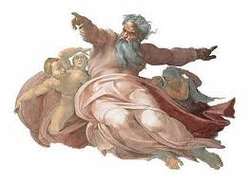
This “I” has the qualities attributed to God: a. Absolute, The One, Perfect Identity, Unity b. Nothing/ Everything c. Unchangeable, Eternal, Omnipresent d. Love

Slide 29
Qualities of Self as Context
Oneness, unity
It all happens by itself – nobody here/emptiness
Timelessness – we have always been here
Loving kindness –compassion
Recognition – familiarity
Silence
Stillness
Vastness
Peace that passes understandig
All is well
Hyper-real certainty of direct experience

Slide 30
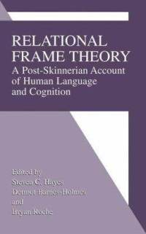
By the way, it would be helpful to develop ACT and RFT.

Slide 31
This sense of observing self is critical to acceptance work because it means that there is at least one stable, unchangeable, immutable fact about oneself that has been experienced directly.

Slide 32
That kind of stability and constancy makes it less threatening for a client to enter into the pain and travails of life, knowing in some deep way that no matter what comes up, the “I” defined as the observing self will not be at risk.” ACT 1 p.186

Slide 33
The Fourth Wave of Behaviorism: ACT, DBT and Nondual Wisdom

Slide 34
This paper can be found published in “Undivided: the Online Journal of Nonduality and Psychology” at http://undividedjournal.com/2012/05/31/the-fourth-wave-of-behaviorism-act-dbt-and-nondual-wisdom/

Slide 35
“Out of the One comes the Two. Out of the Two comes the Three. Out of the Three comes the One as the Fourth.”
-- Axiom of Maria Prophetessa

Slide 36
“The fourth wave knows itself as the ocean.” -- Ram Tirth

Slide 37
ACT and Nondual Wisdom are completely convergent.

Slide 38
Who are you?
a-ontological
de-fusion
acceptance
creative hopelessness
exposure
values

Slide 39
ACT brings us to a doorway –
Nondual Wisdom
steps through it.

Slide 40
In the experience of awakening, one awareness recognizes itself in all beings as “no-self.”

Slide 41
The Fur Coat in the River
Notes:
A poem from Jelalludin Rumi illustrates the difference in these perspectives:
There’s a fur coat floating in the river.
“Jump in and get it,” says the teacher.
You dive in. You reach for the coat.
It reaches for you.
It’s a live bear that has fallen in upstream,
drifting with the current.
“How long does it take!” your teacher yells from the bank.
“Don’t wait,” you answer. “This coat has decided
to wear me home!”(Barks, 1995)
Rumi poems describe many different moments in the flow of awakening towards liberation, some in complete unity with Oneness, others in various states of separation. This one describes the process by which Oneness takes over, but it doesn’t quite make clear that we, as awareness, are the bear that is taking over.
At the beginning of the poem, “you” as the “student” (implied by the word “teacher”) are going after a fur coat as if it is something wonderful that you can take back to shore and wear to be warm, look cool, etc. This would correspond to an ACT client seeking to be happier, healthier, become enlightened, whatever. This is how we all enter onto our paths of healing, and perhaps even spiritual seeking. However, your teacher has tricked you. Instead of getting something that “you” will have for yourself, your life is taken over by what is alive within you as awareness. This “Infinite Mystery,” “no-thing-ness” or “whatever you want to call it” may have a different agenda than what was previously operating the system formerly known as “you.” The bear, your own deepest being as what’s aware, is wearing you home! What you end up doing may be very similar to what has been going on before, if you were in fairly close alignment with the flow of life, or it may be rather different.

Slide 42
“In awakening, there is no individual that awakens. Instead, it is oneness that suddenly recognizes in a new body that it has always been the only being in all forms. After awakening we become a sense organ for oneness, nobody present except for what is aware.” 4th Wave

Slide 43
“No-self” means that emptiness is what sees through our eyes.

Slide 44
The process of embodiment follows the experience of awakening -- all aspects of the personality are pulled into oneness.
Notes:
The amount of comfort or discomfort we experience with the process at this point has everything to do with our ability to surrender to it. Surrender is not really very different from acceptance, though it sounds a bit more threatening. Like Adya, I have a preference for threatening formulations. What Oneness is up to may be the destruction of concepts that are important to your mind, and when that is the case, the experience is like how Jeanne Zande put it: “God moves into your house, and She doesn’t like your furniture!” The journey from awakening to liberation involves the wearing away (or seeing the ineffectiveness) of the mind’s strategic efforts to reassert its claim of being in charge of behavior and experience. The continued demonstration that mind is unable to control reality is painful to the mind and an awareness identified with it, but in moments of clarity we can see the compassion in a universe that pulls us towards awakening and liberation.

Slide 45
Enlightenment = From Awakening to Liberation
In Liberation, awareness no longer responds to the pull back into identification with verbal process.

Slide 46
The PR
shows
this:

Slide 47
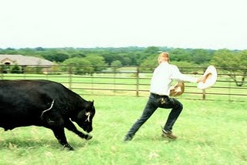
It’s really more like this…
It’s really more like this…

Slide 48
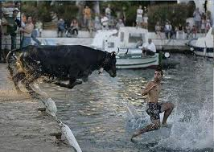
and this…

Slide 49
and this.

Slide 50
Ultimately, the Self takes everything home to itself.
All is well.

Slide 51
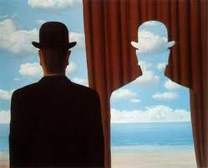
To Be or Not to Be – That is the Question.
To Be and Not to Be – That is the Answer.

Slide 52
What Nondual Wisdom can offer ACT:
1. New metaphors and technologies for transcendence

Slide 53
Going east, values infinitely recede. Going north, you reach a place where you can’t go north anymore.

Slide 54
Everything changes at this mystical singularity.

Slide 55
In spiritual awakening, it becomes obvious that
the bus driver has always been just another passenger – the bus is actually driving itself.

Slide 56
The chess board beneath our individual struggles turns out to be same chess board in touch with everyone!

Slide 57
Like a Magic Eye Stereogram, the multiplicity of human hearts reveals one heart as the spirit of the universe.

Slide 58
What Nondual Wisdom can offer ACT:
2. The deeper we are as therapists, the more effectively we can teach defusion and help clients access Transcendent Self.

Slide 59
I’ll be your therapist today.

Slide 60
Who is experiencing these problems?

Slide 61
What Nondual Wisdom can offer ACT:
3. Therapy without a therapist --therapy by oneness itself.

Slide 62
What is
actually
pulling
the
strings?

Slide 64
Oneness is an excellent therapist.

Slide 65
What Nondual Wisdom can offer ACT:
4. Pointers about the languaging of interventions to avoid pulling clients back into linguistic fusion. For example, “interrogative pronouns” like “who”, and “what”, are more powerful nouns to use than “person”, or “part”.

Slide 66
Adyashanti video: What do you really want?
Notice how much this
looks like ACT stepping
through the doorway.

Slide 67
One Heart

Slide 68
Welcome back!
1. Qualities of Self as Context
2. Evoking Self as Context – practice in dyads and triads
3. Video – deeper into the meeting of science and spirit, and how Steve’s near death experience led to ACT
4. Utilizing death for transformation
5. Adyashanti video clip

Slide 69
Who ACTS? 2/2 may be found on YouTube at http://www.youtube.com/watch?v=IExzAdg5T2Y&feature=relmfu

Slide 70
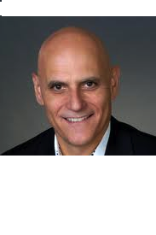
Self as Context is the pivot point of ACT
Historically
Functionally

Slide 71
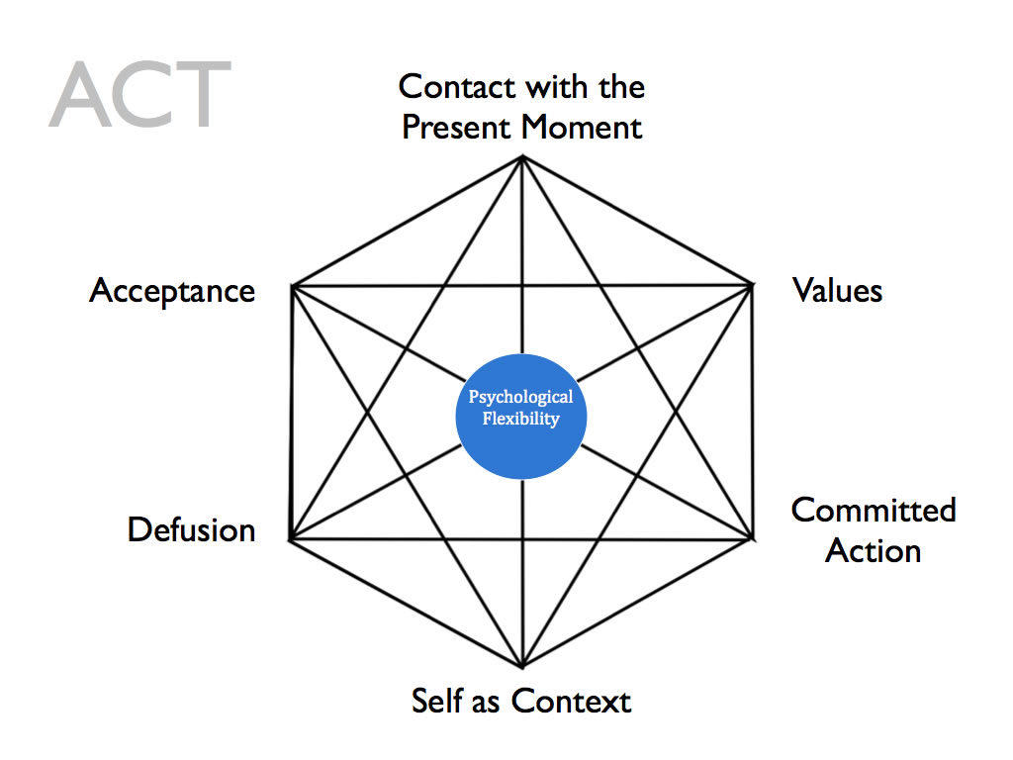

Slide 72
We have to be near death to transcend the body-mind because until that moment awareness is so fascinated by the beauty of a body and mind that it cannot look to what it actually is.

Slide 73
It is only as the body-mind is about to vanish that awareness looks around for another place to go, and discovers itself as the one awareness in everything.

Slide 74
Awareness of death is the beginning of the spiritual path. The death of taking ourselves to be self as content opens the door to self as context. “Kill yourself every day” means letting concepts die. The Sufis say “Die before you die.”

Slide 75
Only as we’re willing to face annihilation over and over and over again, can that which is indestructable within us be revealed, as what we’ve always been.

Slide 76
Many practices intended to bring about awakening simulate the death experience: lengthy silent retreats, long meditations , overnight sitting, fasting, etc.

Slide 77
Using Death to clarify values
If you had a week to live, what would you be doing?
If you had a year to live, what would you do with your time?
If you had 15 minutes to live, what would you do?
If today was your last day on the planet, how would you spend your time?

Slide 78
Qualities of Self as Context
Oneness, unity
It all happens by itself – nobody here/emptiness
Timelessness – we have always been here
Loving kindness –compassion
Recognition – familiarity
Silence
Stillness
Vastness
Peace that passes understandig
All is well
Hyper-real certainty of direct experience

Slide 79
Only the entire context has a Self.
There is no self but the Self.

Slide 80
Qualities of Self as Context
Oneness, unity
It all happens by itself – nobody here/emptiness
Timelessness – we have always been here
Loving kindness –compassion
Recognition – familiarity
Silence
Stillness
Vastness
Peace that passes understandig
All is well
Hyper-real certainty of direct experience

Slide 81
“Self-as-context is not a sense of self that is alone and cut-off…. It is inherently social, expansive, and interconnected because framing is mutually and combinatorially entailed. I begin to experience myself as a conscious human being at the precise point at which I begin to experience you as a conscious human being.” ACT 2, p. 90

Slide 83
“Consciousness is shared…. Consciousness expands across times, places, and persons. In the deepest sense, consciousness itself contains the psychological quality that we are conscious – timelessly and everywhere.” ACT 2, p. 90

Slide 84
The “I” that is “We”, the “We” that is “I”.
The “I” that is“We” – we are connected to everyone.
The “We” that is “I” –there is only one awareness.

Slide 85
“Because perspective taking is social, it is not possible to take a loving, open, accepting, and active perspective on yourself without doing likewise for others…. Thus compassion and self-acceptance are related inside the model.”

Slide 86
Global Empathy
“If we were children in Darfur, and they were us,
and they were starving to death, what would we feel?”

Slide 87
Qualities of Self as Context
Oneness, unity
It all happens by itself – nobody here/emptiness
Timelessness – we have always been here
Loving kindness –compassion
Recognition – familiarity
Silence
Stillness
Vastness
Peace that passes understandig
All is well
Hyper-real certainty of direct experience

Slide 88
“You know about this sense of self indirectly, for example, by a sense of calm transcendence, or peacefulness.” Hayes, (2005) p.95

Slide 89
ACT Techniques for accessing SaXT
Observer Exercise
Therapeutic relationship
Metaphors for context
Looking for what’s the same across time
Notice who is noticing
I am not that
Letter from a wiser future
Non-intentional eye-gazing

Slide 90
Added Nondual techniques for SaXT
Looking into what’s already in acceptance
Noticing qualities like silence, stillness, peace
Noticing what happens by itself, like driving, thinking
Practicing silence
Residing as awareness, allowing everything
Being in the presence of beings who are awake
Being in nature
Chanting, singing, breath practices
Koans – impossible questions to stop the mind
Show me this “ego” – can you find a “person”?

Slide 91
Techniques to try in dyads
Looking into what’s already silent, still, awake.
What is the same across time?
What you as awareness are not – objects across the room, your body, your emotions, your thoughts
What are the qualities of what’s aware? What is silent even as it hears sound, invisible even as it sees, still even as it perceives motion?
Is awareness old or young? Is it male of female?
Can you find boundaries in what’s aware?

Slide 92
“Importing Buddhist practices into the technical armamentarium of cognitive behavior therapy is fine, but it is not a very ambitious step. These concepts and practices are thousands of years old – they are already doing good in the culture…. A real step forward in empirical clinical practice could come, however, by considering

Slide 93
these concepts and practices in scientific terms. That might lead to something new. Scientific psychology is still an adolescent. We do not know how much can be done by approaching ancient sources of wisdom from the point of view of scientific knowing.” Hayes,(2002) Buddhism and ACT, p.66

Slide 94
It’s like a game of hide and seek. We begin by saying “Not It” – not the oneness we’ve always been – and we hide as best we can, knowing we will be “in-free” at the end of the game.

Slide 95
In tension between zero and infinity, the Mandelbrot Set generates elaborate beauty.

Slide 98
At repeated levels of scale, the same image is found, just as we are said to made in God’s image.

Slide 100
Pespective Taking in Emptiness
“As a thing is viewed, so it appears.”
Padmasambhava
Everything depends on how you look at it.
--Joe Miller
“The Sufi is one who sees from the point of view of another.” Hazrat Inayat Khan

Slide 101
“I do not know is the only true statement the mind can make. . . . The biggest drawback to understanding is the concept that I am an entity and secondly, that any concept I have is truth. . . . You have not understood until you have solved the riddle of the one who thinks he has understood.”
--Nisargadatta Maharaj

Slide 102
The ego is like one’s shadow thrown on the ground. If one attempts to bury it, it will be foolish. The Self is only one. If limited, it is the ego; if unlimited it is the Infinite and is the Reality.
--Ramana Maharshi

Slide 103
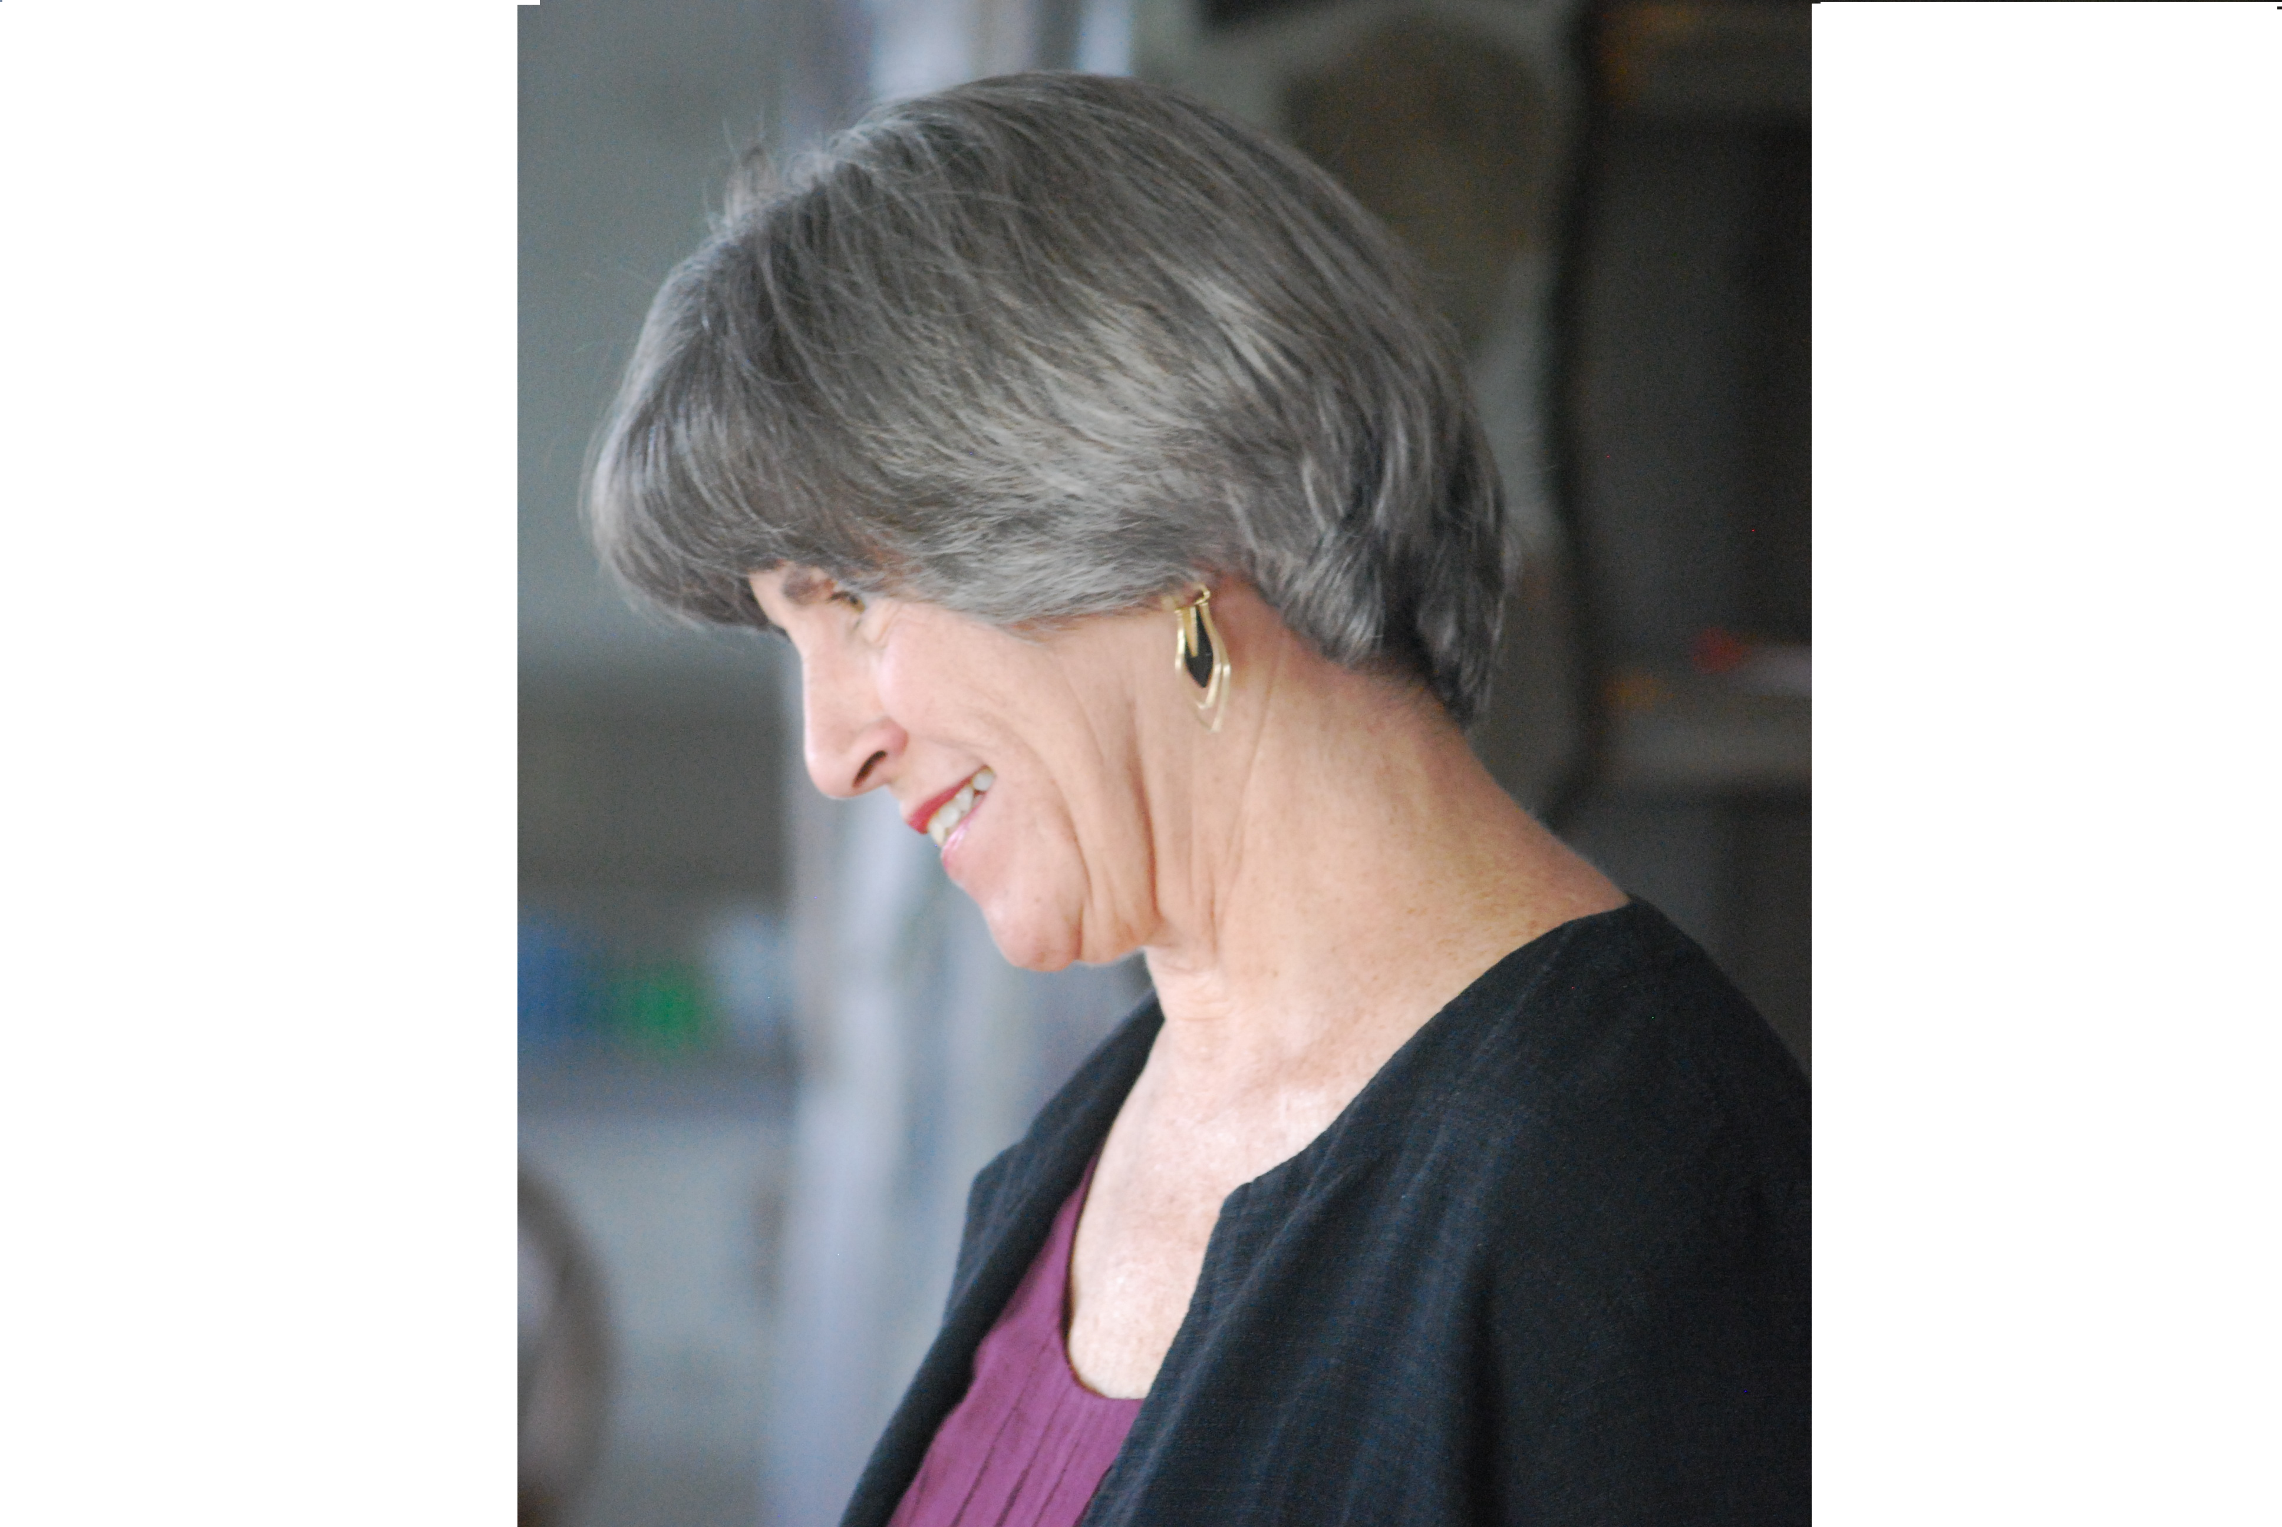
Such investigation may reveal that ego is not an enemy to be overcome, or an identity to be improved, but rather an illusion. In the process called awakening, ego, or identified consciousness, simply becomes transparent. The ideas that egoic consciousness holds of “separation” and “control” are simply seen by the deeper dimension of our “whole” being to be illusory.
-- Dorothy Hunt

Slide 104
“In order to give consistent verbal reports, children have to develop a sense of perspective – a point of view – and to distinguish their own from that of others. Even as the contents of these descriptions begin to weave a self-story – which can be limiting – the sense of perspective is growing – which can be liberating.” ACT 2, p.86

